Slide 1
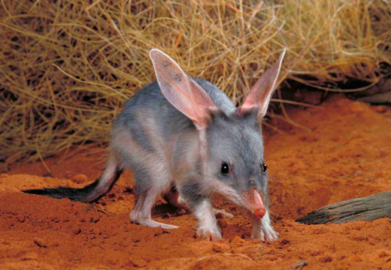
Part A Habitat and Interactions: Threatened Organisms:
5 points
Natures Wonderland, (2014). The Greater Bilby. [image] Available at: http://www.natureswonderland.com.au/shop/the-bilby [Accessed 9 Aug. 2014]
By Lachlan Bell 7Lynch

Slide 2
Threatened organisms
In Queensland threatened species are grouped as endangered, extinct or vulnerable.

Slide 3
Species in Queensland that are becoming threatened
A species is considered endangered or threatened if any of the following occur:
There have not been thorough searches for the species and it has not been seen in the wild
The habitat of the species has been reduced so that it may be in danger of extinction
The population of the species has decreased so that it maybe in danger of extinction
The survival of the species in the wild is unlikely if a threatening process continues
An extinct species has not been seen in the wild for a long period. A vulnerable species is a decreasing population of a species because of a threatening process.

Slide 4
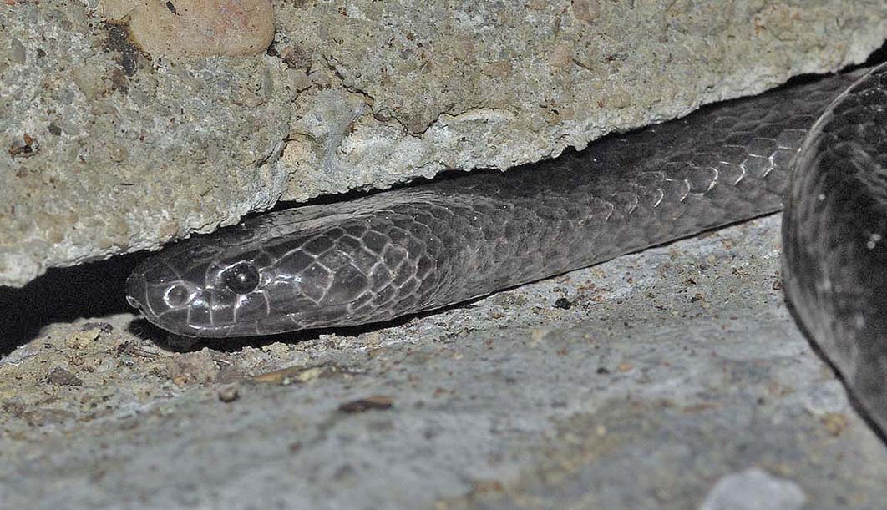
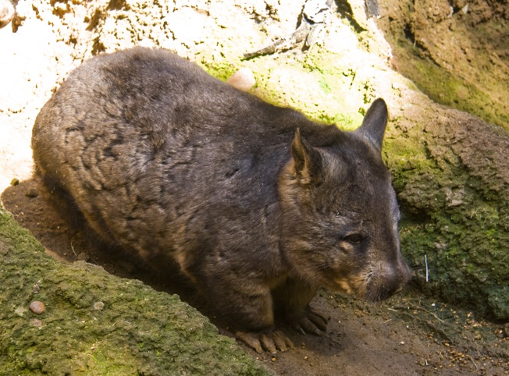
Names of species in Queensland that are threatened
The Queensland Government lists the threatened species in Queensland on its website. There are 15 species of amphibians, 16 species of Birds, 2 species of Invertebrates, 4 species of Fish, 15 species of Mammals and 11 species of reptiles (Queensland Nature Conservation)
Some endangered species in Queensland are:
Torrent Tree Frog
Swift parrot
Grey nurse shark
Northern Hairy Wombat
Spotted Tail Quoll
Grey Snake
Loggerhead Turtle
Greater Bilby
Bunyipco, (2014). Grey Snake. [image] Available at: http://bunyipco.blogspot.com.au/2012_04_01_archive.html [Accessed 7 Aug. 2014].
Wikipedia, (2014). Northern Wombat. [image] Available at: http://en.wikipedia.org/wiki/Southern_hairy-nosed_wombat [Accessed 6 Aug. 2014].

Slide 5
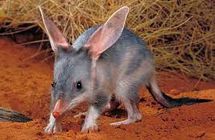
Species chosen for task
The Greater Bilby
The Greater Bilby is a marsupial mammal that belongs to the bandicoot family.
FactZoo, (2014). Bilby. [image] Available at: http://www.factzoo.com/mammals/bilby-burrower-long-ears-muzzle.html [Accessed 7 Aug. 2014].

Slide 6
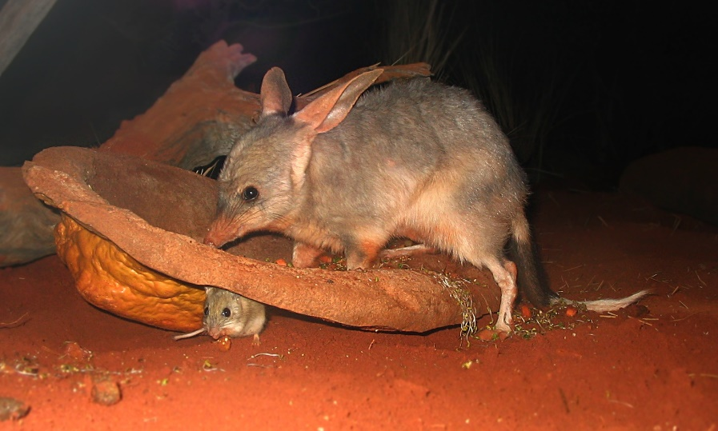
The Greater Bilby
Scientific name: Marcrotis Lagotis
The Bilby is a marsupial mammal that belongs to the bandicoot family. It is about the size of a rabbit. They have soft-silky fur, long “rabbit-like” ears, and a long black tail and at the end of the tail they have white hairs.They run along the ground all on four feet. They use their strong paws for digging burrows. The female Bilbies have a pouch to carry their young like all marsupials.
Wikipedia-Dcoetzee, (2014). Bilby and baby. [image] Available at: http://en.wikipedia.org/wiki/Greater_bilby [Accessed 5 Aug. 2014].

Slide 7
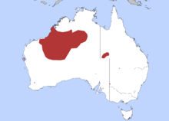
Habitat
The Greater Bilby was found all over Australia hundreds of years ago. Now the Greater Bilby is only found in a few places such as in Western Queensland. One of the largest remaining groups in Queensland is in the Mitchell grassland of Southwest Queensland. The Greater Bilby is also found in the deserts of the Northern Territory and Western Australia. They lived in a deserts were the soils are rocky or sandy and covered in acacia shrub. They can also survive in dry grasslands. Bilbies live in underground burrows that are about 2 metres deep and 3 metres long. The burrow provides protection from predators and the sun. They come out at night to find food. They prey on grasshoppers, beetles, spiders and fruit. The Bilbies predators include goannas, cats, foxes, dingoes, snakes and large birds of prey.
Wikipedia, (2014). Map of Bilby. [image] Available at: http://en.wikipedia.org/wiki/Greater_bilby [Accessed 6 Aug. 2014].

Slide 8
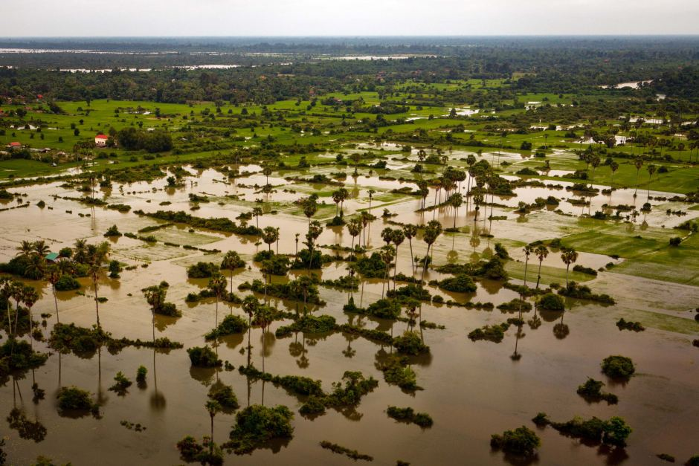
Reasons for decrease in population
The most important threats that have contributed to the decrease in Bilby population are:
Habitat loss and change
Competition with introduced animals
Feral predators
The Bilbies habitat changed as farming activities extended over parts of Australia. Overtime there has also been a change to Australia's fire pattern which affected the Bilbies habitat and supply of food. When artificial water supplies were made available in desert areas, this allowed predators to live in the same desert areas where the Bilbies also lived. There has also been competition with introduced animals such as cattle and sheep that eat the same plants. Rabbits also compete with the Bilbies with their food and burrows. Predators such as foxes and feral cats have killed the Bilbies and have threatened their survival.
http://www.abc.net.au/news/2011-10-14/flooding-in-cambodia-in-pictures/3571430
ABC, (2014). Natural Disaster. [image] Available at: http://www.abc.net.au/news/2011-10-14/flooding-in-cambodia-in-pictures/3571430 [Accessed 9 Aug. 2014].

Slide 9
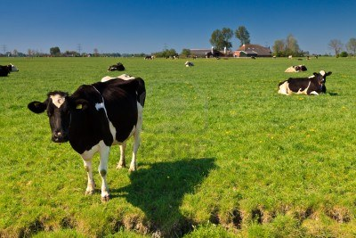
Influence of human activity on species
Humans have contributed to the decrease in the Bilby population by:
Reducing and destroying their habitat by building houses on their land.
Farming land with cattle and sheep that have destroyed burrows and the Bilbies habitat as well as taking over their supply of food and water.
Humans have introduced domestic animals that have killed the Bilbies.
Early settlers used to trap the Bilbies and take them as pets or use its long silky fur.
Taylor Mobile Homes, (2014). Farmland. [image] Available at: http://www.taylorsmobilehomes.co.uk/agricultural-and-equestrian.html [Accessed 11 Aug. 2014].

Slide 10
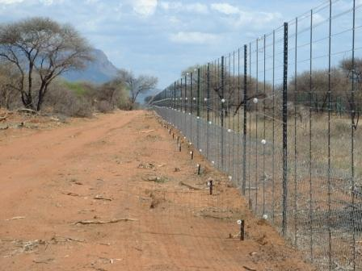
Ways to conserve species population
The Bilby is protected in Australia. A recovery plan has been made to give the Bilbies an opportunity to survive.
The actions include:
Protecting the Bilbies remaining habitat
Programmes for breeding in captivity
Monitoring the population of the species
Establishing Bilbies in areas were they once lived
In the Queensland town of Charleville a project has been set up called save the Bilby. A predator proof fence at Currawinya National Park, Western Queensland, was built to prevent predators from entering a 29 square kilometres of habitat. The release of Bilbies into the enclosure has been successful with an increase in population of the Bilbies.
TNH Fencing, (2014). Predator Proof Fence. [image] Available at: http://www.tnhwildlife.com/PhotoGallery-WildlifeFences.html [Accessed 7 Aug. 2014].

Slide 11
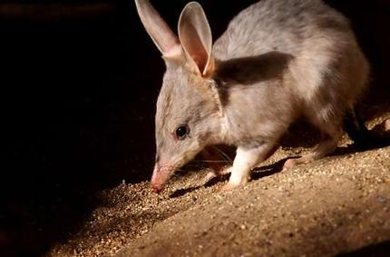
Save the Bilby
The Save the Bilby project is based in Queensland
The project has made the Easter Bilby popular as a alternative to the Easter bunny. Chocolates can be bought at Easter to raise money for save the Bilby fund.
Other actions that can be taken by individuals to help the survival of the Bilby include donating time or money to save the Bilby group, protecting the habitat of the Bilby, supporting local projects for endangered species and supporting research on Bilbies.
Save the Bilby, (2014). Bilby. [image] Available at: http://www.smh.com.au/news/queensland/fund-to-save-the-endangered-bilby/2006/08/07/1154802806919.html [Accessed 11 Aug. 2014].

Slide 12
References
Easterbilby.com.au, (2014). Factsheet. [online] Available at: http://www.easterbilby.com.au/Project_material/factsheet.asp [Accessed 8 Aug. 2014].
Ehp.qld.gov.au, (2014). Greater bilby (Department of Environment and Heritage Protection). [online] Available at: http://www.ehp.qld.gov.au/wildlife/threatened-species/endangered/endangered-animals/bilby.html [Accessed 5 Aug. 2014].
Environment.gov.au, (2014). Bilby (Macrotis lagotis) - Publications. [online] Available at: http://www.environment.gov.au/resource/bilby-macrotis-lagotis [Accessed 18 Aug. 2014].
Sites.google.com, (2014). Australian Greater Bilby 6ML. [online] Available at: https://sites.google.com/a/leopold.vic.edu.au/australian-greater-bilby-6ml/ [Accessed 18 Aug. 2014].

