Slide 1
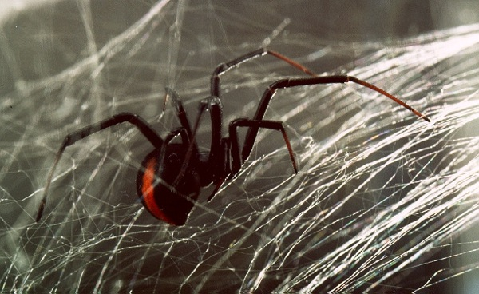
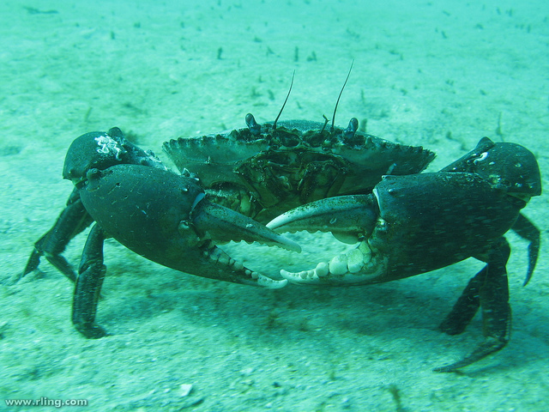
Classification project part b 5 points
Richard Ling, (2014). Mud Crab. [image] Available at: https://www.flickr.com/photos/rling/5910736176/ [Accessed 7 Sep. 2014].
Animal Time, (2014). Red Back Spider. [image] Available at: http://animalstime.com/red-back-spider-facts-red-back-spider-diet-habitat/ [Accessed 9 Aug. 2014].
By Lachlan Bell 7Lynch

Slide 2
Animal phyla chosen
Phylum Arthropoda:
They are the largest animal phylum on the planet
All arthropod have the following same essential characterics:
A hard external skeleton called an exoskeleton
A segmented body
Jointed legs
Symmetrical body
No back bone
Cold blooded

Slide 3
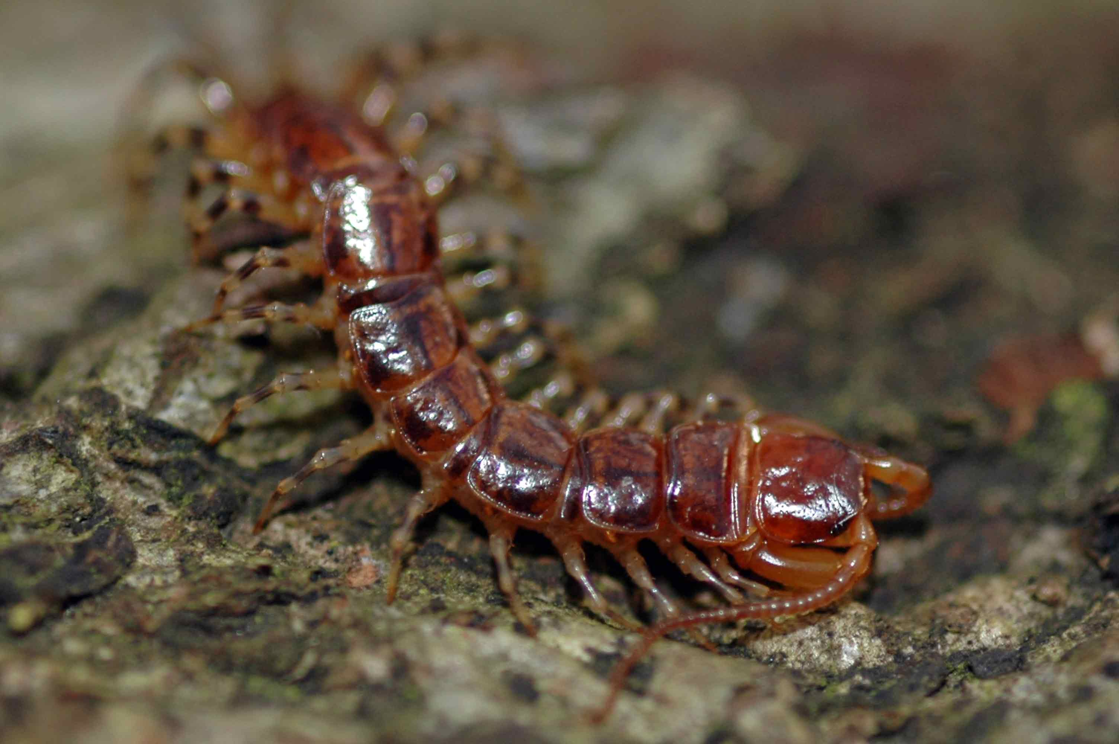
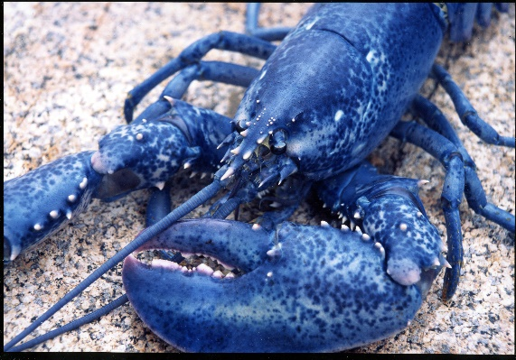
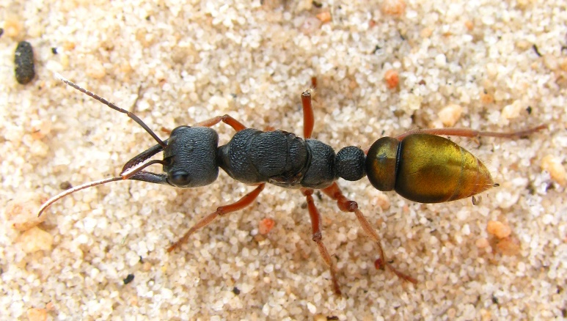
Some of the animals in the phylum Arthropoda
Ethmostigmus rubripes (species of centipede)
Sydney Funnel Web Spider
American Blue Lobster
Reddishvale, (2014). Centipede. [image] Available at: http://www.reddishvale.moonfruit.com/#/common-centipede/4532414871 [Accessed 3 Sep. 2014].
Animal Time, (2014). Red Back Spider. [image] Available at: http://animalstime.com/red-back-spider-facts-red-back-spider-diet-habitat/ [Accessed 9 Aug. 2014].
Nursemyra, (2014). Blue Lobster. [image] Available at: https://nursemyra.wordpress.com/2011/09/page/2/ [Accessed 4 Aug. 2014].
Bull Ant
Mud Crab
Project Noah, (2014). Bull ant. [image] Available at: http://www.projectnoah.org/spottings/699826003 [Accessed 7 Aug. 2014].
Richard Ling, (2014). Mud Crab. [image] Available at: https://www.flickr.com/photos/rling/5910736176/ [Accessed 7 Sep. 2014].

Slide 4
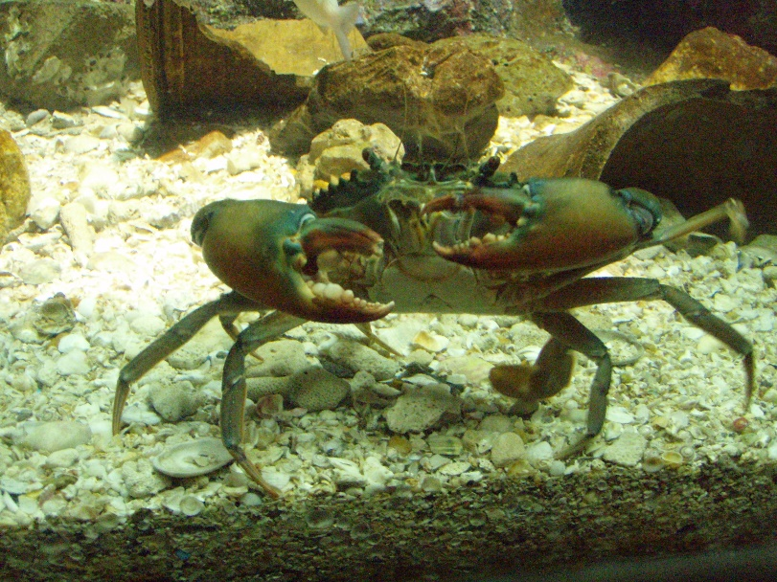
Arthropod chosen
Mud Crab:
This crab is also know as the Green Mud Crab. It belongs to the crustacean sub-phyla of the Arthropoda phylum. It is in the Malacostraca Class and the Decapoda Order.
Like all crabs, the mud crab has 10 legs with the first leg modified to form big claws and the last pair of legs flattened for swimming. They have a smooth outer shell that is usually deep green to dark brown in colour. The Mud Crab can grow up to 30cm in shell width and weigh up to 2.5 kg.
LetsTravelandFood, (2014). Mud Crab. [image] Available at: http://latztravelandfoods.wordpress.com/2012/04/29/visit-the-rayong-aquarium-for-a-glimpse-into-thailands-awesome-tropical-marine-life/ [Accessed 11 Aug. 2014].

Slide 5
Biological classification
Mud Crab
Kingdom: Animalia
Phylum: Arthropoda
Subphylum: Crustacea
Class: Malacostraca
Order: Decapoda
Family: Portunidae
Genus: Scylla
Species: S. serrata

Slide 6
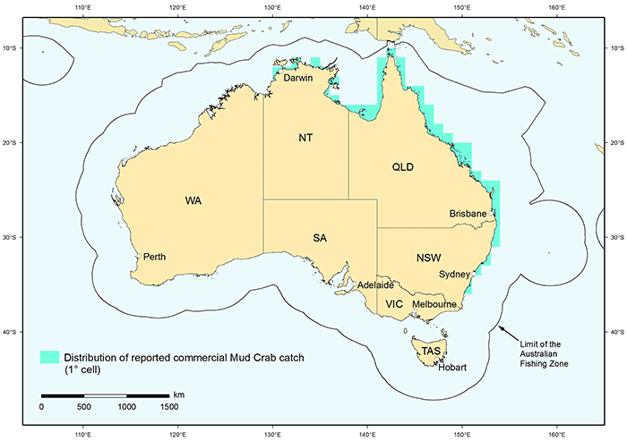
Habitat of the Mud Crab
Mud crabs inhabit tropical or warm waters from Exmouth in Western Australia, along the coast line of the Northern Territory, Queensland and down to the Bega River in New South Wales. They’re also found along the coasts of the Indian and Pacific oceans.
They prefer to live in shallow water and prefer a soft muddy bottom below the tide level. They usual live in estuaries, mud flats, mangrove forests and some rivers. They're tolerant of changes in their environment such as temperature or the salt level in the water. They bury themselves in the mud during the day.
Fish Flies, (2014). Mud Crab Map. [image] Available at: http://www.fishfiles.com.au/knowing/species/crustaceans/crabs/Pages/Mud-Crab.aspx [Accessed 7 Aug. 2014].

Slide 7
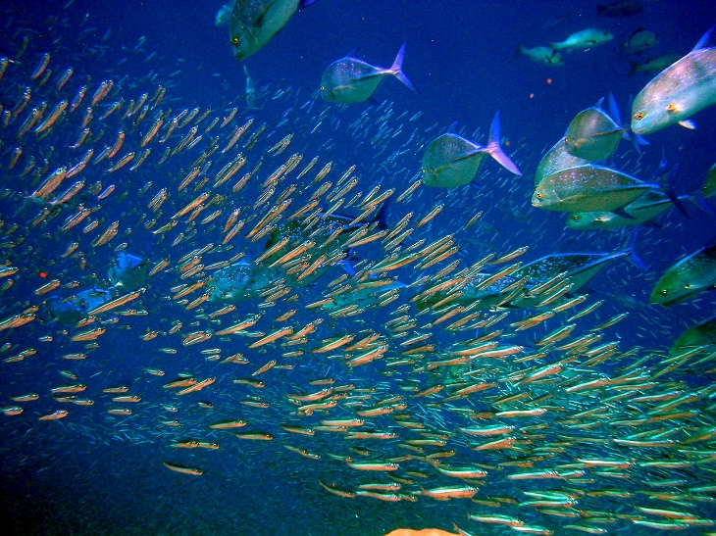
How THE Mud CRab feeds and what they feed on
When the mud crab catches their food, they use their large claws to crush their prey and the smaller claw to cut it. The claws of the mud crab are very powerful. The mud crab also uses their senses to find food. The eyes of the mud crab are on stalks so that they can see in and out of the water and can see in a 360 degree range. They have two antennae that can detect changes in the movement of the water. The tips of the mud crab’s legs are covered in small hairs that are very sensitive to any touch or taste.
Mud crabs come out of their burrows at night to look for food. The adult crabs feed on slow moving animals such as molluscs, mussels, pipis, small crabs and worms. They are cannibals and they also eat plants.
Wikipedia, (2014). Pelagic fish. [image] Available at: http://en.wikipedia.org/wiki/Pelagic_fish [Accessed 9 Aug. 2014].

Slide 8
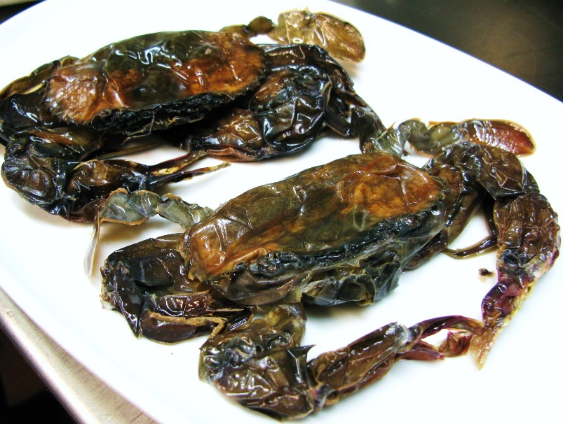
Importance of mud crabs to humans
Mud crabs are known for their delicious taste. They can be cooked with their shells and served as soft shell crab. They are one of the most popular type of seafood in Australia.
In some parts of Australia mud crab fishery is commercial. Mud crabs also have good export potential and have been sold locally and overseas. They are often bought alive in seafood markets. Their big claws can cause a serious wound to humans.
Mud crabs are also popular with recreational fishers. Crab traps or pots are used to catch them. In Queensland the law states that a person is only allowed to catch and have in their possession 10 crabs.
Humans also have a responsibility to protect the Mud carbs habitat. People should walk carefully on any mud flats, stay away from mangroves roots, and avoid destroying burrows.
EPICUREADDICT, (2014). Soft Shell Crab. [image] Available at: http://epicureaddict.wordpress.com/2010/07/15/soft-shell-crab-no-we-dont-soak-it-in-vinegar-to-make-it-go-soft/ [Accessed 9 Aug. 2014].

Slide 9
Comparing animals in arthropod Phylum
List of other animals in the arthropod phylum:
Sydney Funnel Web Spider
Bull Ant
Rusty Millipede
Ethmostigmus rubripes (species of centipede)
Mud Crab
Blue Bee
Why are these animals classified together in the arthropod phylum:
All arthropods have the following same essential characterics:
A hard external skeleton called an exoskeleton
A segmented body
Jointed legs (Used for feeding, movement and sense)
Symmetrical body
No back bone
Cold blooded

Slide 10
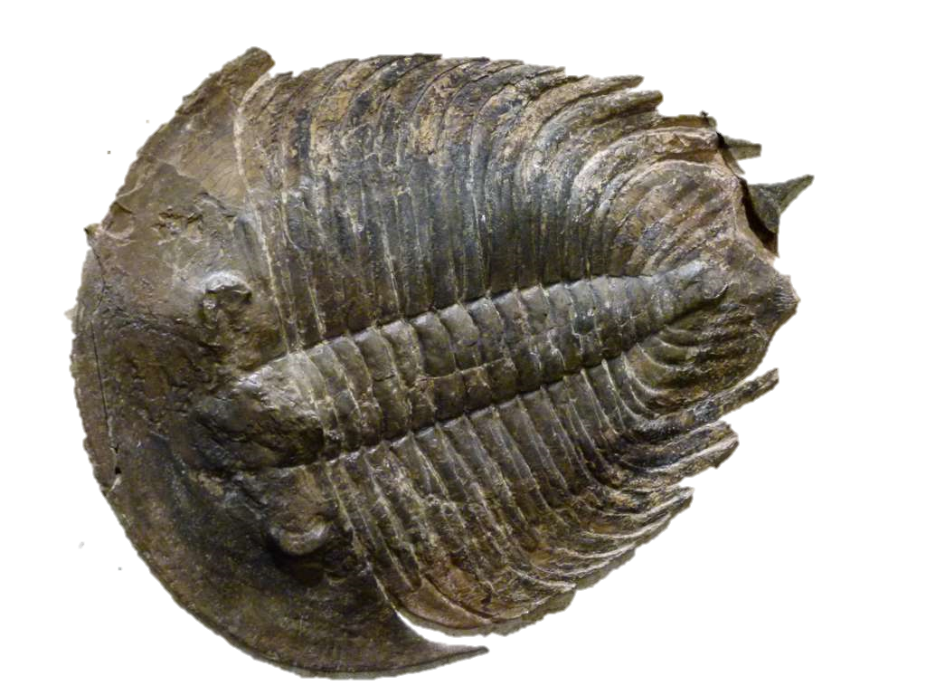
Differences between the animals in the arthropod phylum
These characterics are used to classify the arthropods into different classes:
Number of antennae
Number of legs
Number of body parts
Qualicum Beach Museum, (2014). Arthropod fossil. [image] Available at: http://www.qbmuseum.ca/paleontology/ [Accessed 2 Sep. 2014].

Slide 11
Differences between arthropods
The phylum is divided into these sub-phyla and classes:
Chelicerates sub-phyla-contains the Arachnids and Meristomata classes. They have:
No antennae
4 pairs of legs (Arachnids) or 5 pairs of legs (Meristomata)
2 body parts
Crustaceans sub-phyla-contains the Remipedia, Cephalocarido, Branchiopoda, Maxillopoda and Malacostraca classes. They have:
2 pairs of antennas
8 or more legs
2 or 3 body parts
Uniramians sub-phyla-contains the insect and Myriapods classes. They have:
1 pair of antenna
6 legs (Insects) or 18 or more legs (Myriapods)
3 body parts (Insects) or 2 body parts including head and segmented trunk (Myriapods)

Slide 12
Differences between arthropods chosen
Arthropoda
1 pair of antennae or none
2 pairs of antennae (crustacean)
No antennae Arachnids
(Sydney Funnel Web spider)
1 pair of antennae
2 body parts Malacostraca (Mud Crab)
2 body parts
3 body parts Insects(Bull ant, Blue Bee)
1 pair of legs per trunk segment (Centipede)
2 pairs of legs per trunk segment (Millipede)

Slide 13
Arthropods disappearing?
The phylum Arthropoda is greater than most other phyla. They’re more than 90% of the animal kingdom. They live in nearly every habitat. Therefore, because of these reasons they’re very important to all the organisms and environments of the whole planet.
Without the arthropods, life on this planet would eventually disappear.
There would be disruption to habitats .
There would be changes to the usual food chain. Arthropods are often 1st order or 2nd order consumers. Arthropods supply food for amphibians, fish, birds, mammals, reptiles. These changes would cause a decrease or disappearance of other organisms.
Insects are also the pollinators of flowering plants

Slide 14
References
Business.qld.gov.au, (2014). Mud crab aquaculture | Queensland Government. [online] Available at: http://www.business.qld.gov.au/industry/fisheries/aquaculture/aquaculture-species/mud-crab-aquaculture [Accessed 12 Aug. 2014].
Dpi.nsw.gov.au, (2014). Mud Crab | NSW Department of Primary Industries. [online] Available at: http://www.dpi.nsw.gov.au/fisheries/recreational/saltwater/sw-species/mud-crab [Accessed 8 Aug. 2014].
Fish.wa.gov.au, (2014). Mud crabs. [online] Available at: http://www.fish.wa.gov.au/Species/Mud-Crabs/Pages/default.aspx [Accessed 9 Aug. 2014].
Insected.arizona.edu, (2014). Arthropod Information. [online] Available at: http://insected.arizona.edu/arthroinfo.htm [Accessed 4 Aug. 2014].
Mesa.edu.au, (2014). Crustaceans. [online] Available at: http://www.mesa.edu.au/crustaceans/default.asp [Accessed 14 Aug. 2014].
Mudcrabsdirect.com.au, (2014). Faqs, Mud Crabs Direct. [online] Available at: http://www.mudcrabsdirect.com.au/Faqs/Faqs-15/ [Accessed 6 Aug. 2014].
Teacher.scholastic.com, (2014). Science Explorations: Classify Insects: Zoom in on True Bugs: Arthropods | Scholastic.com. [online] Available at: http://teacher.scholastic.com/activities/explorations/bug/libraryarticle.asp?ItemID=108&SubjectID=147&categoryID=4 [Accessed 1 Sep. 2014].
Wikipedia, (2014). Scylla serrata. [online] Available at: http://en.wikipedia.org/wiki/Scylla_serrata [Accessed 7 Aug. 2014].

